Slide 1
Business Intelligence Project
Analyzing Kiva Loans Dataset
Analytics Avengers Team

Slide 2
Team Member:
Sondos Ahmed Abdullah
Sohaila Mohamed Ahmed
Sara Abdullah Abbas
Aya Mohamed Fekry
Rahma Aladdin Youssef
Doha Sayed Mahmoud

Slide 3
OUR AGENDA
Introduction
Project Objectives
Dataset Description
Data Exploration
Data Preprocessing
Business Questions
Machine Learning & Model Development
Time Series Analysis
Conclusion

Slide 4
INTRODUCTION

Slide 5
INTRODUCTION
Kiva organization is an online crowdfunding platform to extend financial services to poor and financially excluded people around the world.
Kiva lenders have provided over $1 billion dollars in loans to over 2 million people. In order to set investment priorities, help inform lenders, and understand their target communities, knowing the level of poverty of each borrower is critical.
Kiva is in 83 countries, with about 2.7 Million borrowers.
It also has around 450 volunteers worldwide

Slide 6
PROJECT OBJECTIVES

Slide 7
OUR OBJECTIVE
Help Kiva build more localized models to estimate the poverty/welfare levels of residents in the regions where Kiva has active loans.
To know Which sectors receive the highest funding
Correlation between lender count and funded amount
Predicting future loan amounts

Slide 8
DATASET DESCRIPTION

Slide 9
Data Description
Columns name | Description of attributes
ID | Unique identifier for each loan.
Funded amount | The amount of money funded for the loan.
Loan amount | The total amount of money requested for the loan
Sector | The sector for which the loan is intended
Country | The country where the loan is being provided.
Partner Id | Identifier for the partner organization facilitating the loan.
Term in months | The term of the loan in months.
Lender count | The number of lenders contributing to the loan.
Borrower genders | Genders of the borrowers (e.g., female, male).
Repayment Interval | The interval at which repayments are made (e.g., irregular, bullet).
Date | The date when the loan was initiated.
The dataset consists of various attributes related to each loan.
Have 10 attributes
Shape Of Data
33561 Rows
11 Columns

Slide 10
DATA EXPLORATION

Slide 11
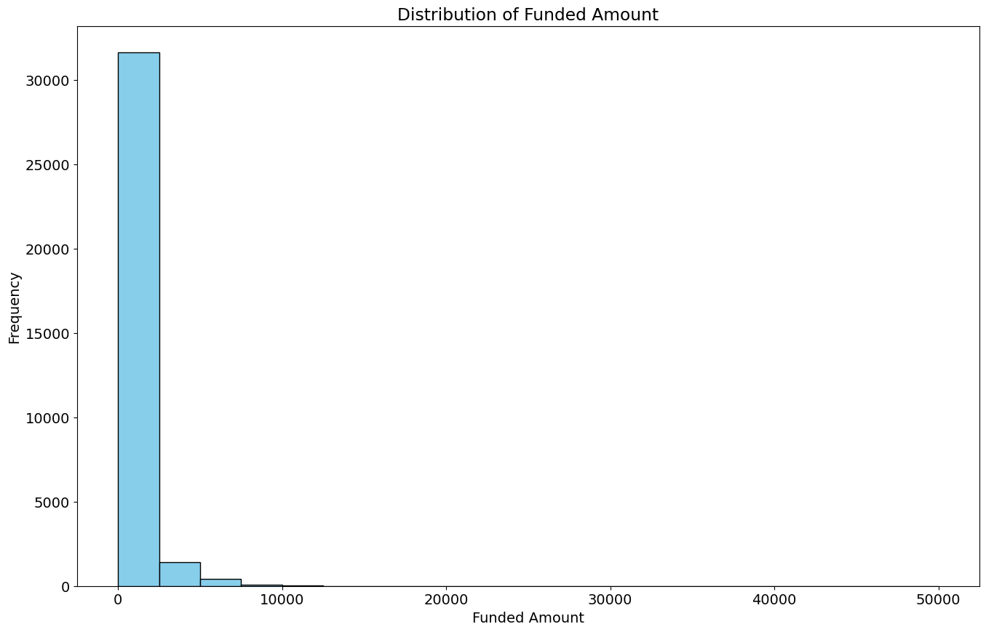
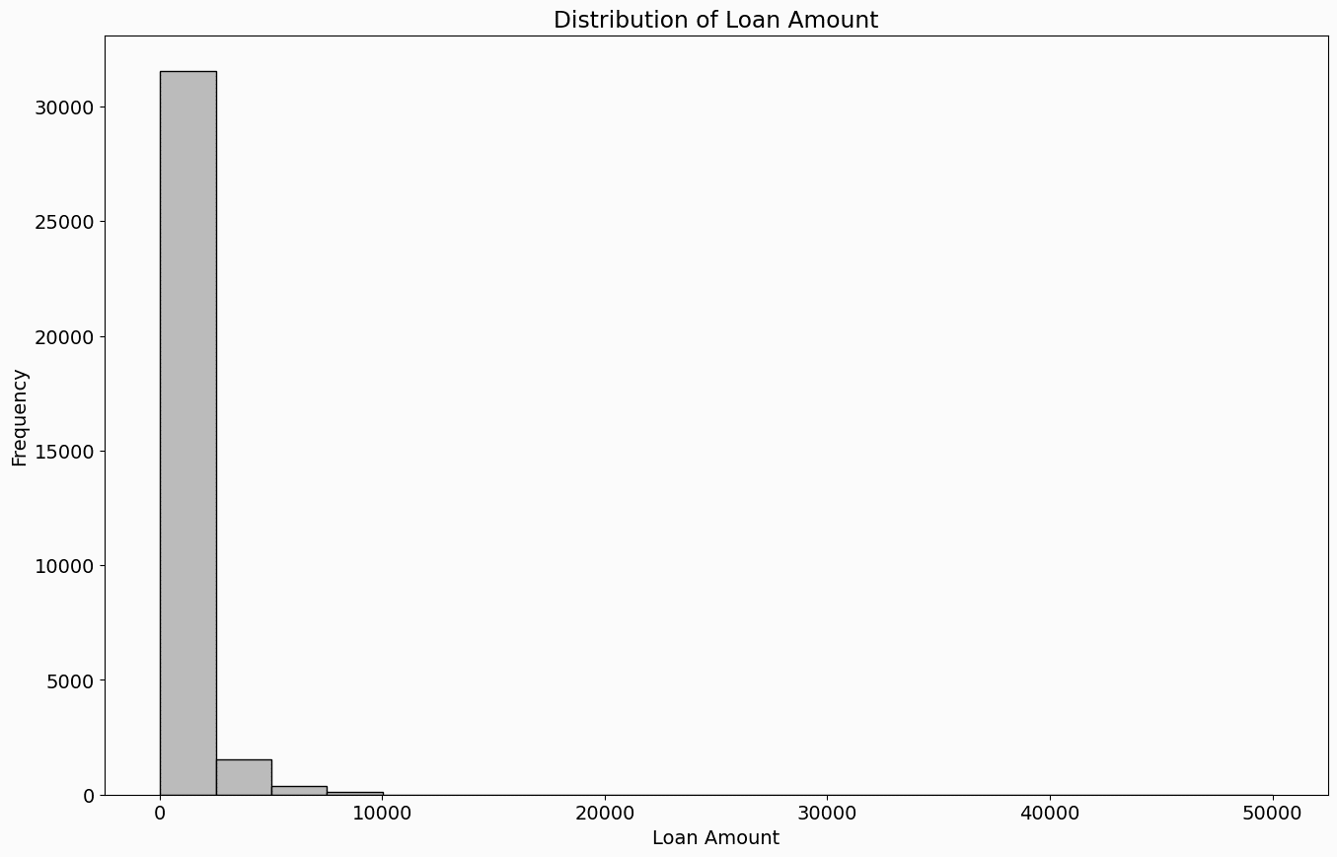
Loan Amount
Maximum Value : 50000
Minimum Value : 25
Mean : 843.059653
Funded Amount
Maximum Value : 50000
Minimum Value : 0
Mean : 789.871279

Slide 12
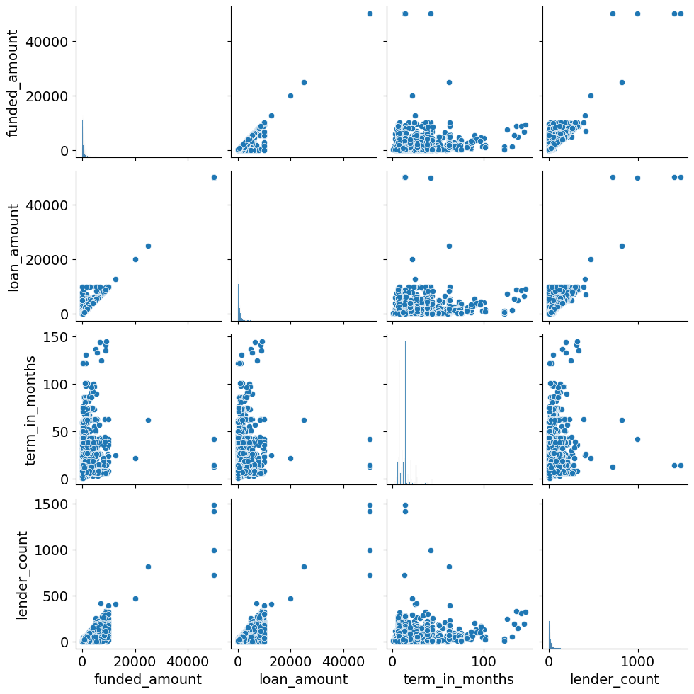
Correlation Between every Columns

Slide 13
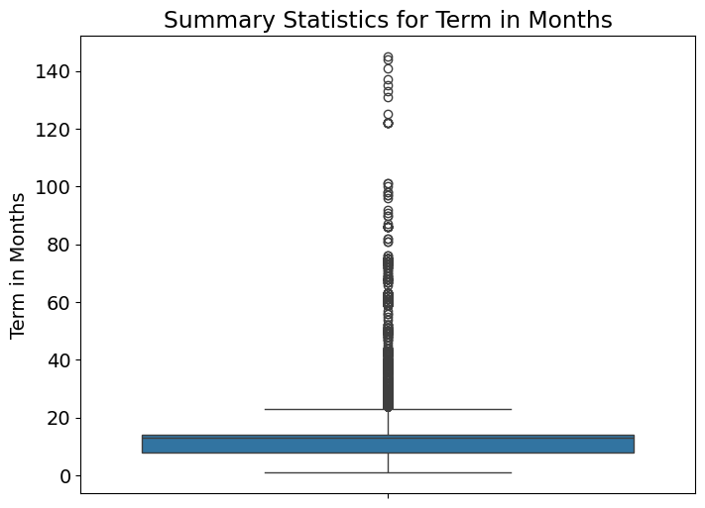
Term In Months
Maximum Months is 145$
Minimum Month is 1$
Mean is 14$

Slide 14
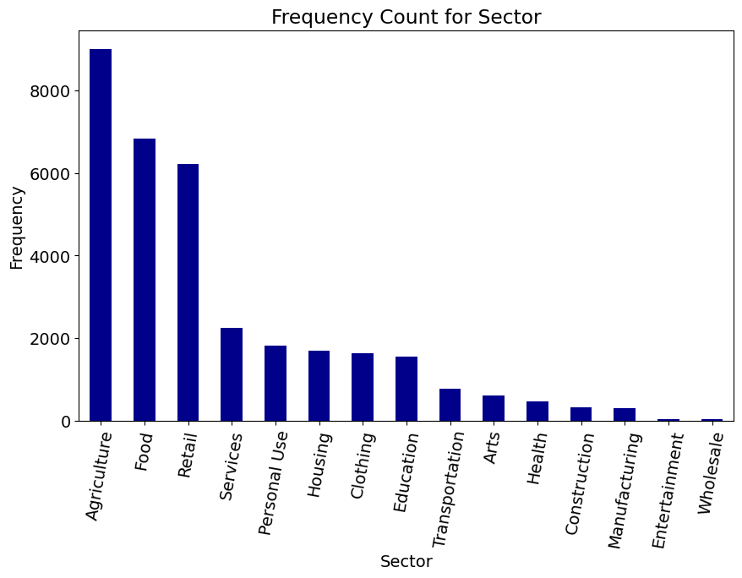
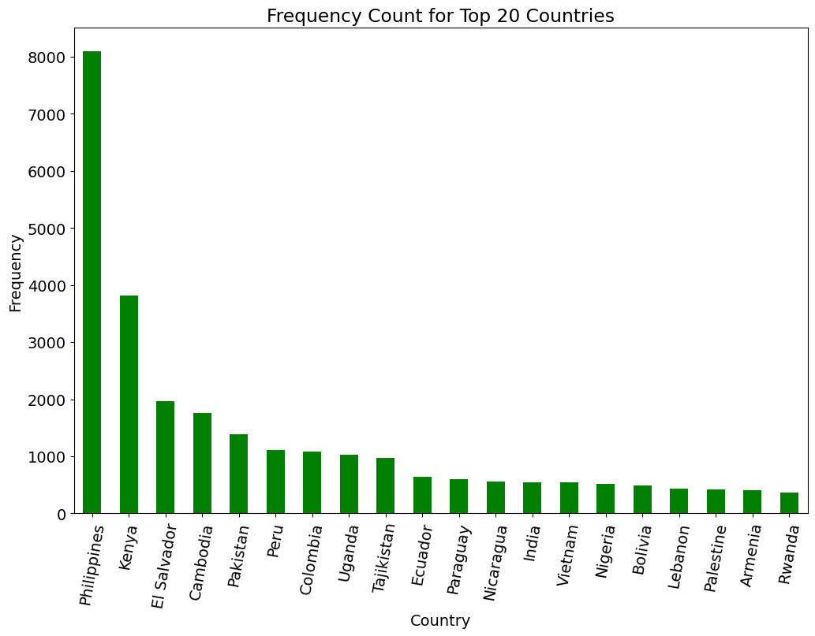
Sector & Country
Sector Frequency
Country Frequency

Slide 15
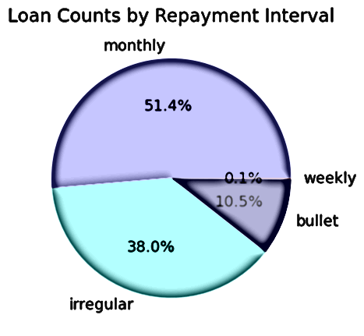
Repayment Interval
Four Type of Interval:
Monthly
Irregular
Bullet
Weekly
Monthly repayment is the most common interval , followed by irregular and bullet repayment intervals.
Weekly repayment has the lowest frequency.

Slide 16
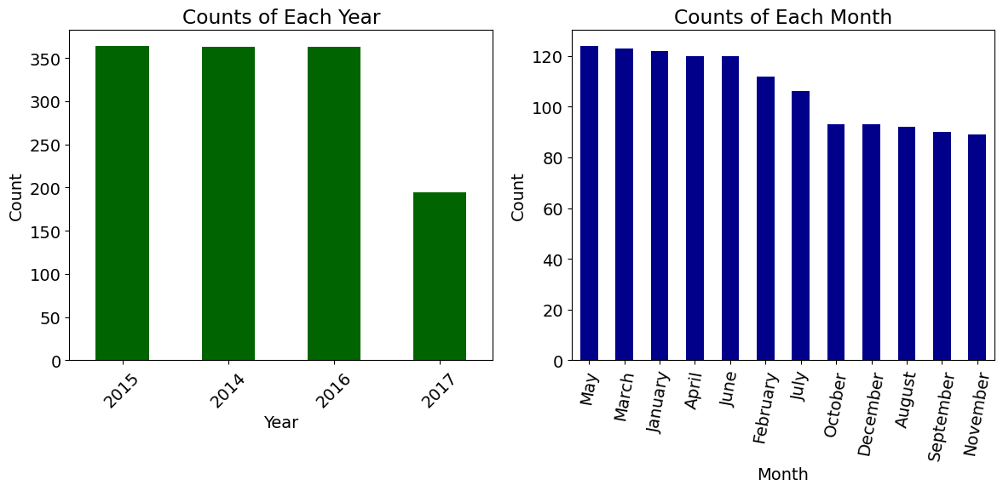
Month with the most occurrences: May, Count: 124
DATE
We have Four years in our Data :
2015 : have 364 loans
2014 : have 363 loans
2016 : have 363 loans
2017 : have 194 loans
We Show over year that May have Highest Amount of loans

Slide 17
DATA PREPROCESSING

Slide 18
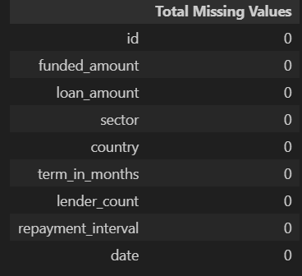
Data Cleaning & Transformation
First , Apply Transformation Methods
Drop TWO unnecessary
Borrower genders
Partner id
Change data type of column date to datetime
Converting datetime values to Unix timestamps is a common practice to ensure compatibility with machine learning algorithms that require numeric input.
Check NULLs
No, Exist NULLs
Checking for Duplicated Rows
No duplicated rows found.

Slide 19
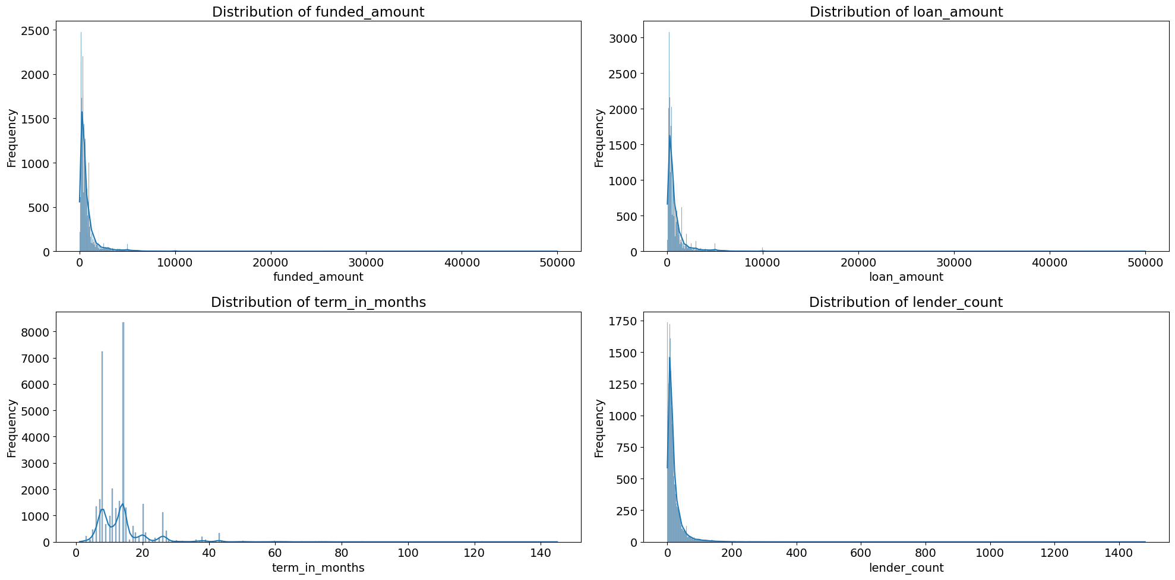
Handling Outliers
We check if there exist outlier in this numerical columns “funded amount , loan amount , term in months and lender count” Using Distribution Plots

Slide 20
Handling Outliers
We try to handle outliers
Using IQR that we are remove any value more than Q3+1.5*IQR less than Q3-1.5*IQR it handle outliers prefect and data close to normal distribution but we will have nulls
Using trimming method to remove outliers
it handle outliers prefect and data close to normal distribution but we will drop a lot of rows in data
Shape of data frame before removing outliers: (33561, 9)
Shape of data frame after removing outliers: (23046, 9)
Using Winsorization as a technique used to handle outliers in a dataset , replaces them with the nearest non-outlier value.
THE BEST is Winsorization

Slide 21
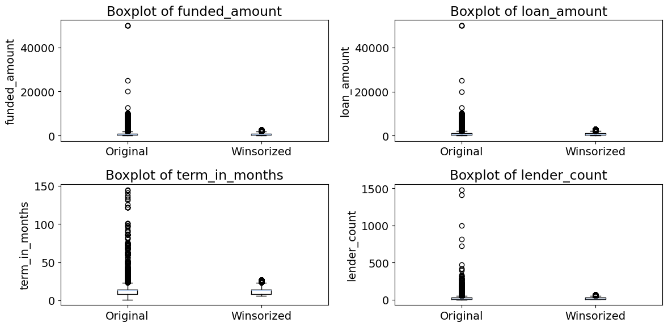
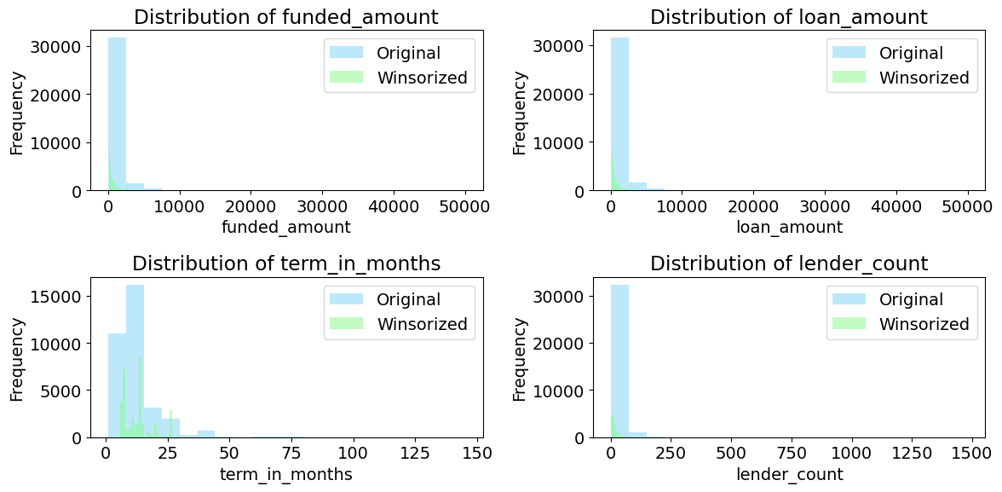
Handling Outliers
Let’s How Winsoriztion effort on Outliers

Slide 22
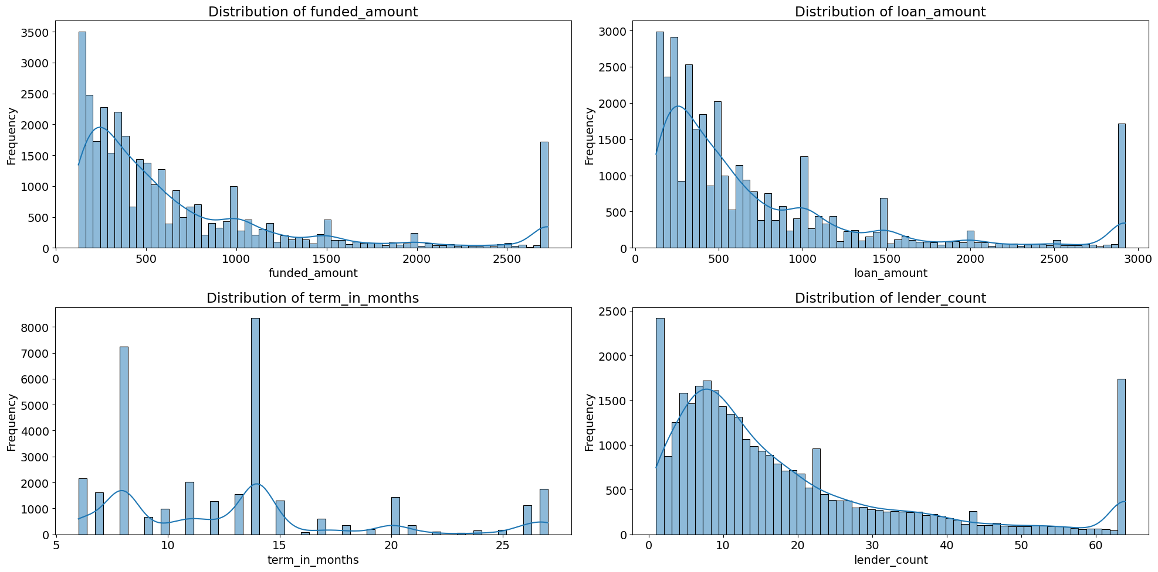
Handling Outliers
We check distribution of data after remove Outlier

Slide 23
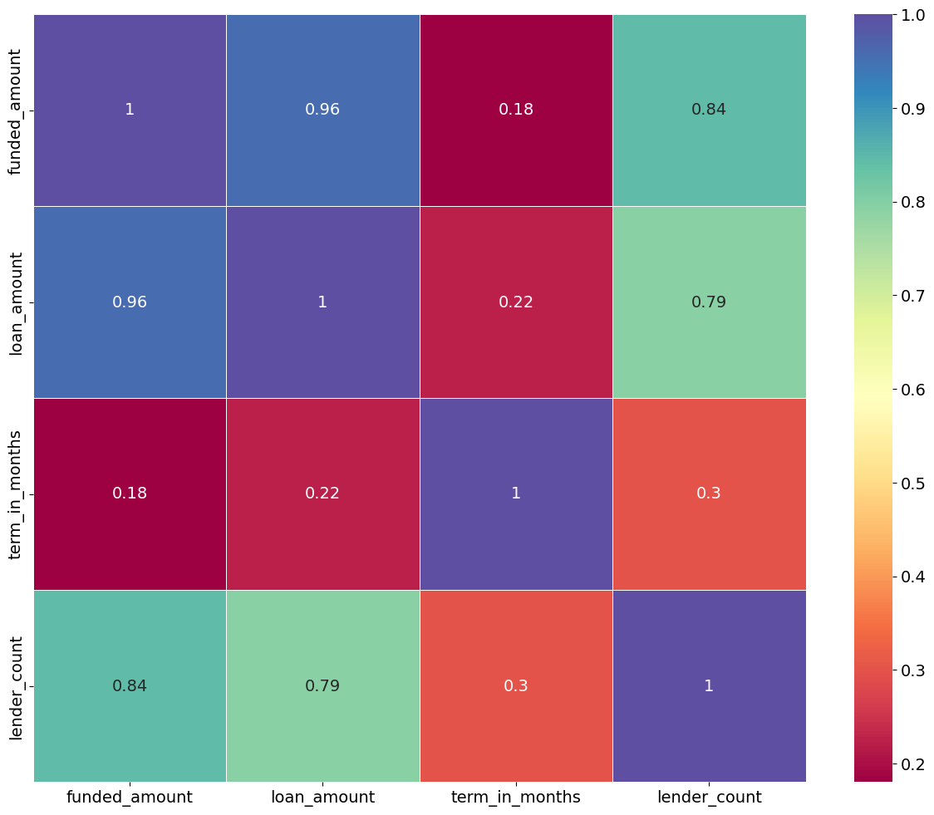
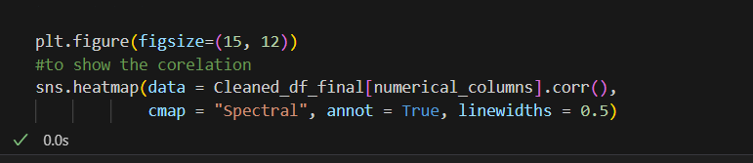
Relation Between Numerical Columns After Cleaning
Use heatmap to see correlation between each column and another

Slide 24
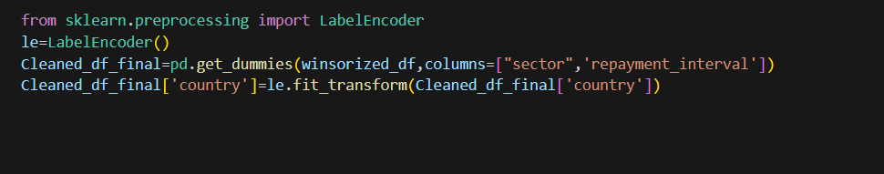
Creating Dummy Variables
Do encoding using get dummies on this category columns "sector "repayment interval" and use Label Encoder on country
WHY do ?
Necessary for :
for handling categorical variables, which are variables that represent categories rather than numerical values.
Machine Learning Algorithms
Improving Model Performance

Slide 25
BUSINESS QUESTIONS

Slide 26
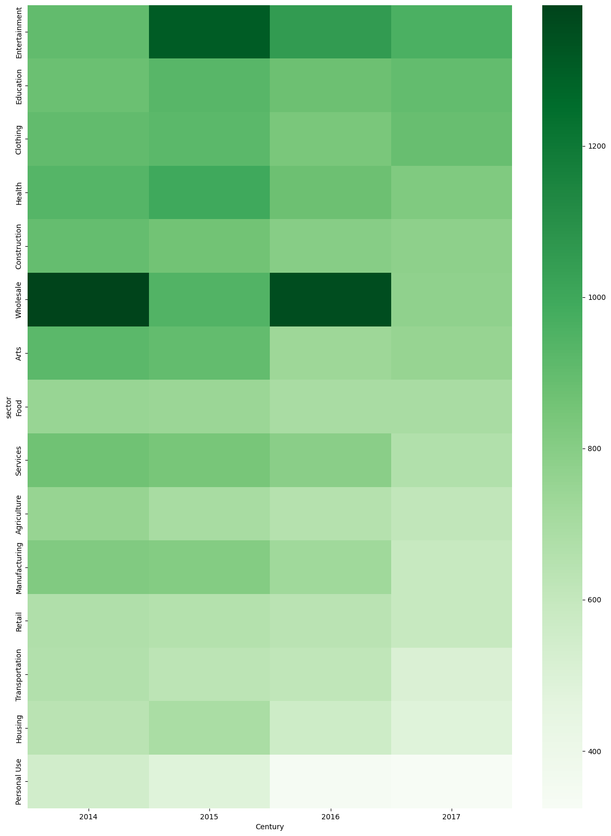
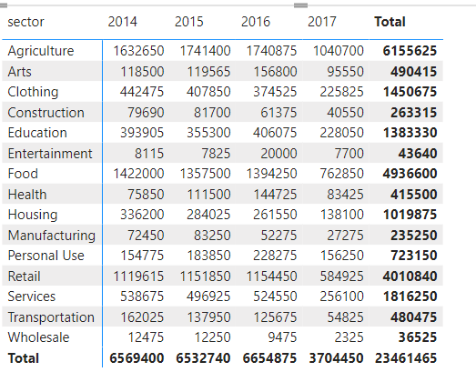
Which sectors receive the highest amount of funding, and how does this change over time?

Slide 27
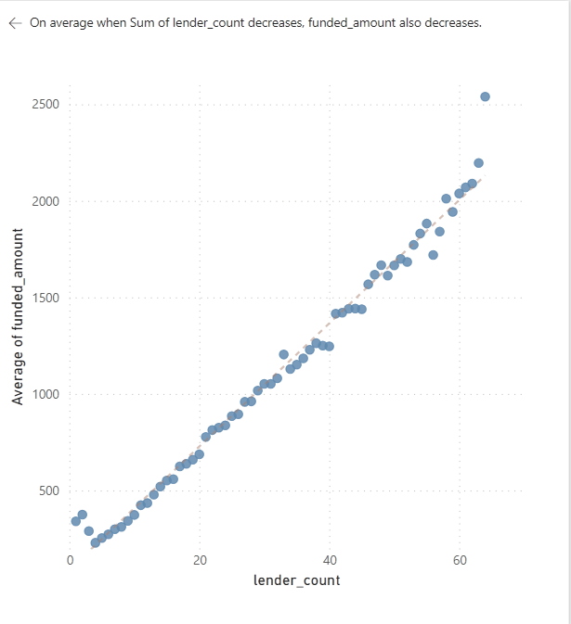
Is there a correlation between the number of lenders and the funded loan amount?
Each point on the plot represents a loan, with the x-coordinate indicating the loan amount requested and the y-coordinate indicating the amount actually funded.
As the funded amount increases, there seems to be a slight positive correlation with the lender count, indicating that loans with higher funded amounts tend to attract more lenders. However, this relationship is not strictly linear, as some loans with lower funded amounts also have a high lender count.

Slide 28
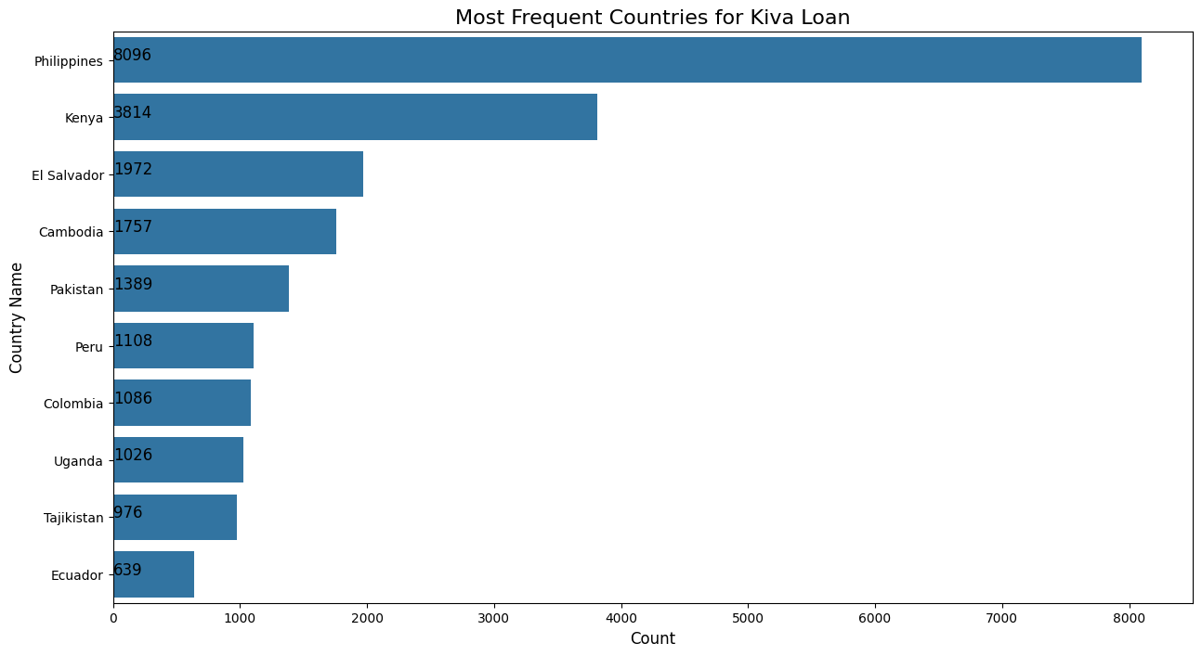
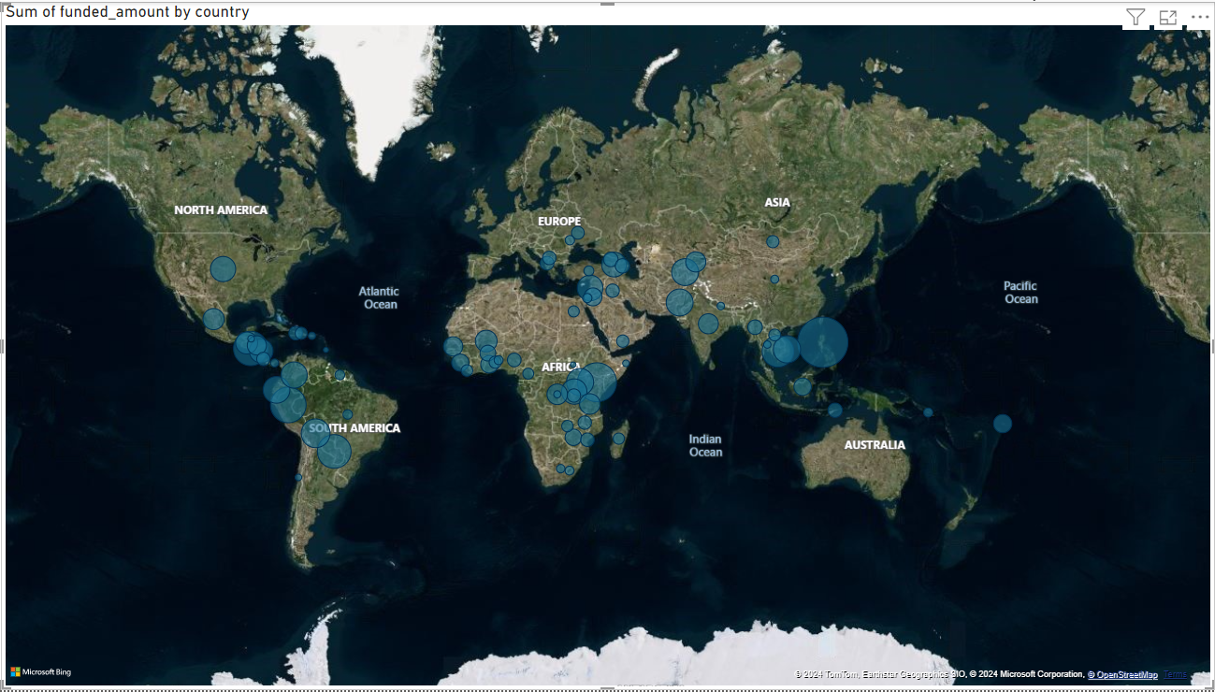
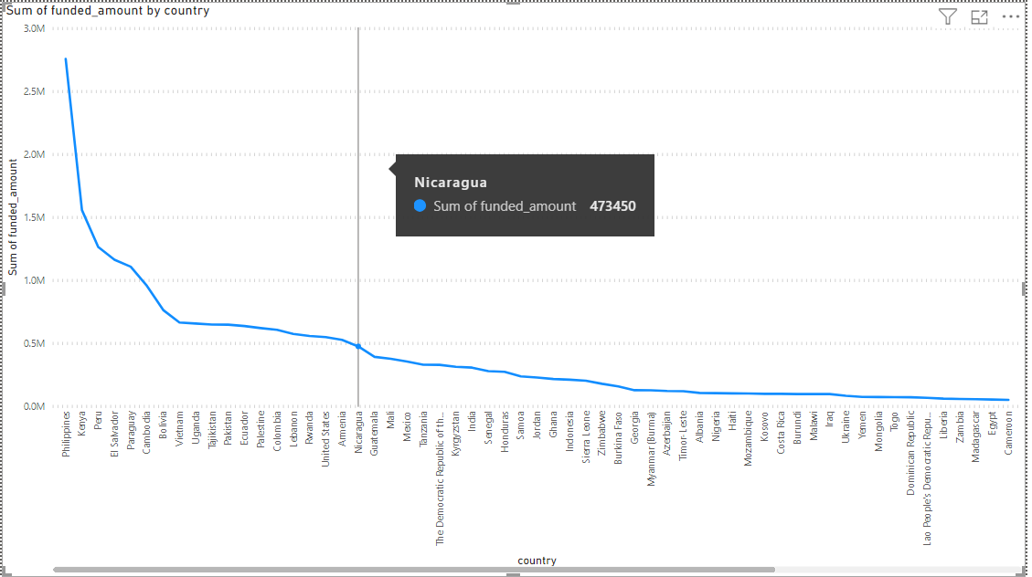
Which country receive the highest amount of funding?
Philippines have High Total Amount

Slide 29
MACHINE LEARNING MODEL

Slide 30
Model Selection
Our problem is a regression problem, as you're trying to predict a continuous numerical value (the amount of the loan). In regression, the goal is to estimate a continuous target variable based on one or more input features.
Suitable Algorithm Can Apply On It:
Linear Regression
Random Forest Regressor
Gradient Boosting Regressor
Support Vector Regressor (SVR)
Polynomial Regression
Polynomial Regression with Decision Tree Regressor

Slide 31
Based on the metrics you’ve provided, here’s an analysis of the performance of each algorithm:
Random Forest Regressor:
Training Set: Excellent performance with a high R2 score of 0.9963.
Testing Set: Good performance with an R2 score of 0.9780, but the increase in error metrics (MAE, MSE, RMSE) suggests a potential overfitting as the model performs significantly better on the training set than on the testing set.
XGBoost Regressor:
Training Set: Very good performance with an R2 score of 0.9942.
Testing Set: Good performance with an R2 score of 0.9794, similar to Random Forest, indicating possible overfitting.
Support Vector Regressor (SVR):
poor performance ,seems to underfit the data
Linear Regression:
Training and Testing Sets: Consistent performance with R2 scores of 0.93 and 0.929 respectively. The model is generalizing well without significant overfitting or underfitting.
Polynomial Regression:
The training and testing errors (MAE, MSE, RMSE) are very similar.
The R2 scores for both sets are also nearly identical.Train:0.865,Test:0.8629
polynomial regression model shows a balance between training and testing performance, suggesting it is well-fitted and not overfitting.
Polynomial Regression with Decision Tree Regressor:
Training Set: Good performance with an R2 score of 0.9195.
Testing Set: Slightly lower performance with an R2 score of 0.9094, suggesting a slight overfitting.

Slide 32
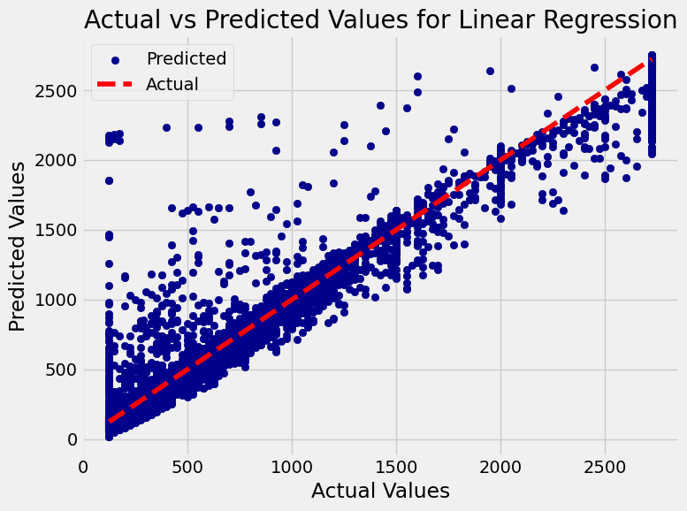
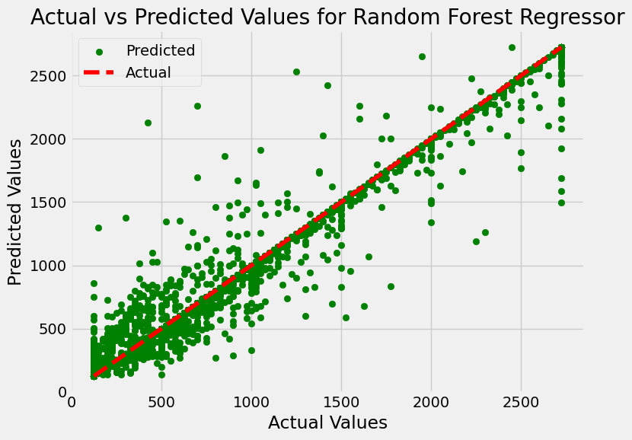
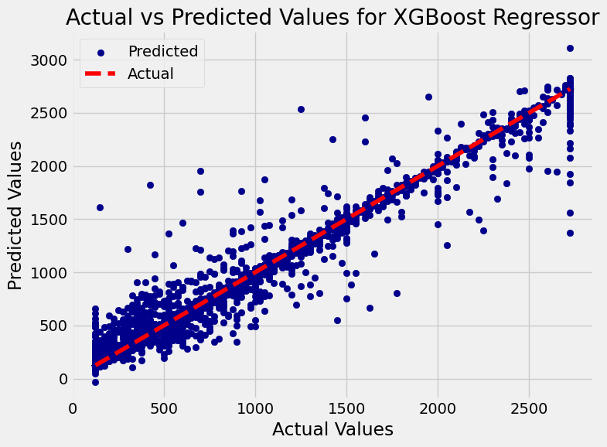
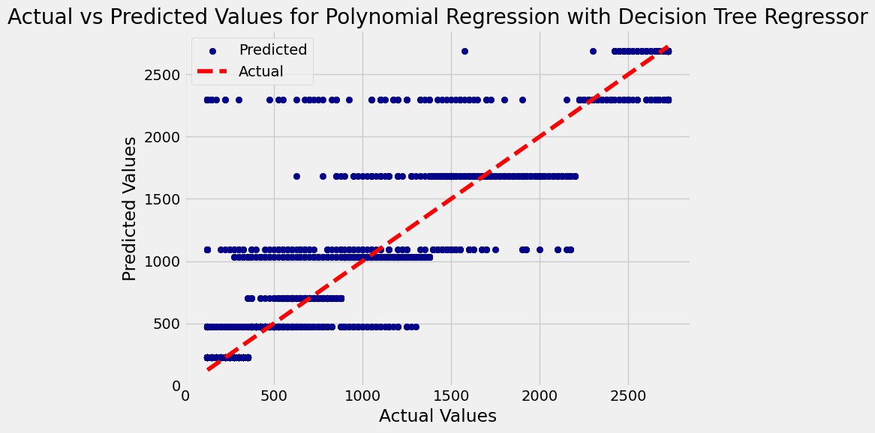
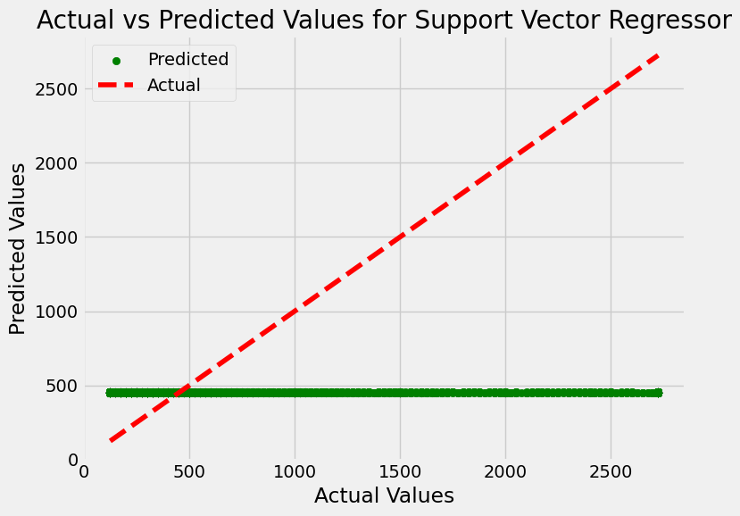
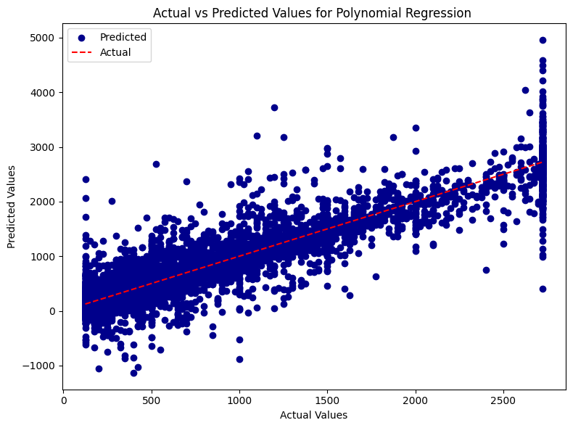
Comparison of Results

Slide 33
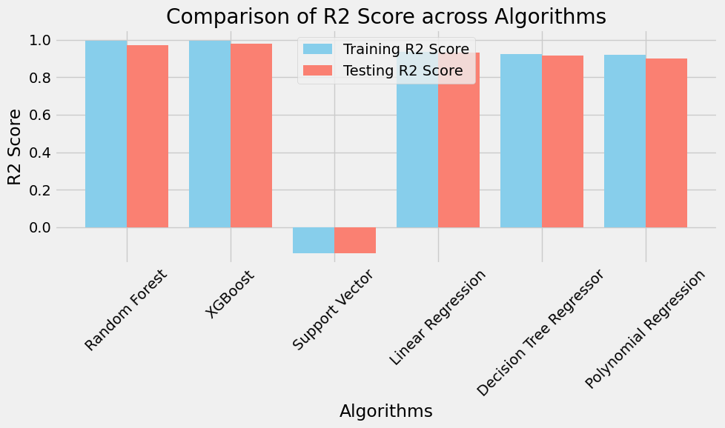
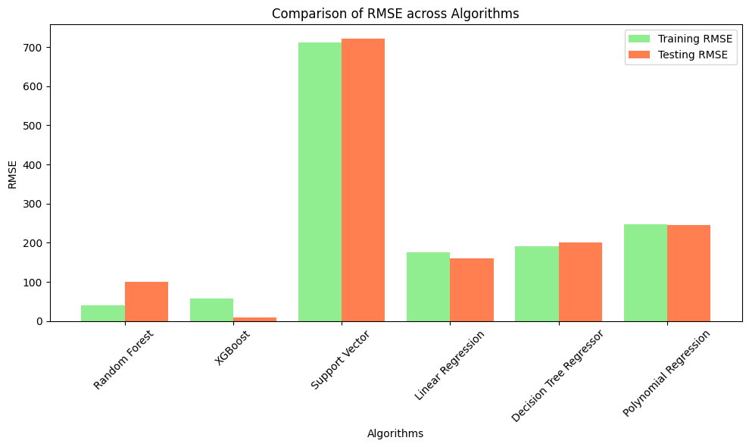
Comparison of Results

Slide 34
TIME SERIES ANALYSIS

Slide 35
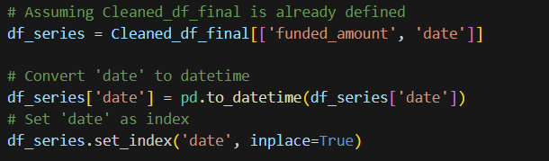
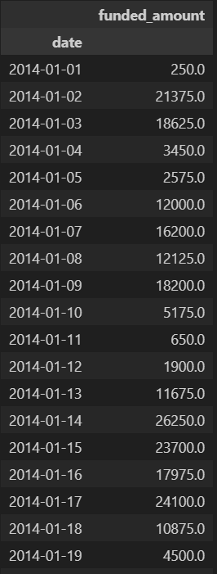
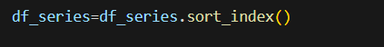
Forecasting Kiva Loan Funded Amounts Using ARIMA Model
Let’s answer?
• Can we predict future loan amounts based on historical data?
yes, we can predict future loan amounts to a certain extent using historical data use time series .
We take from data 2 Columns (funded_amount ,data)
set index date and sort it
Group by data to remove duplicated
Sample of data

Slide 36
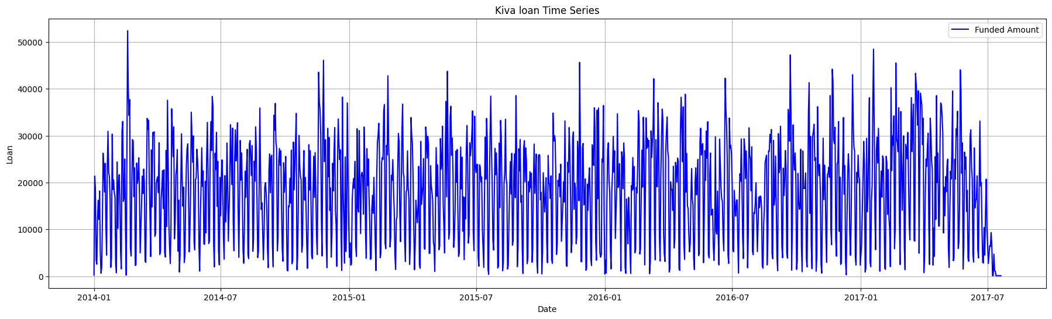
Visualization

Slide 37
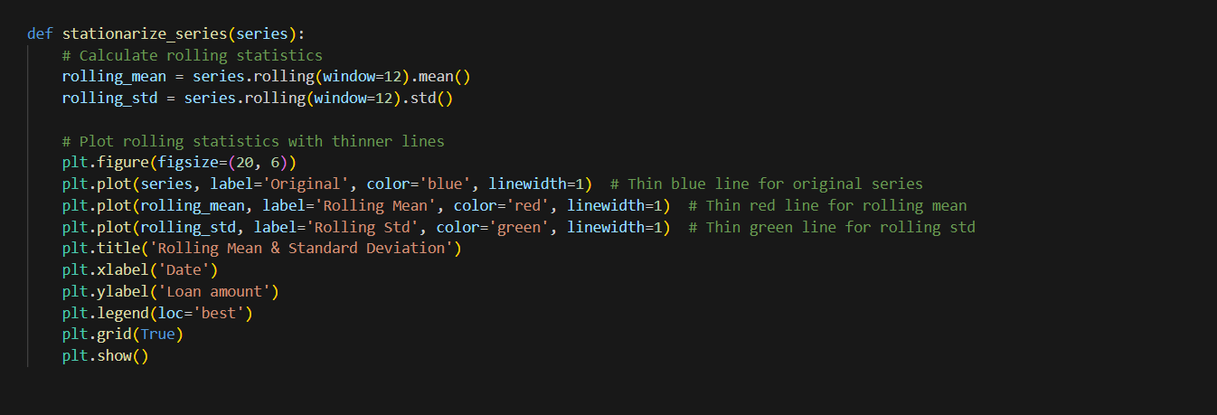
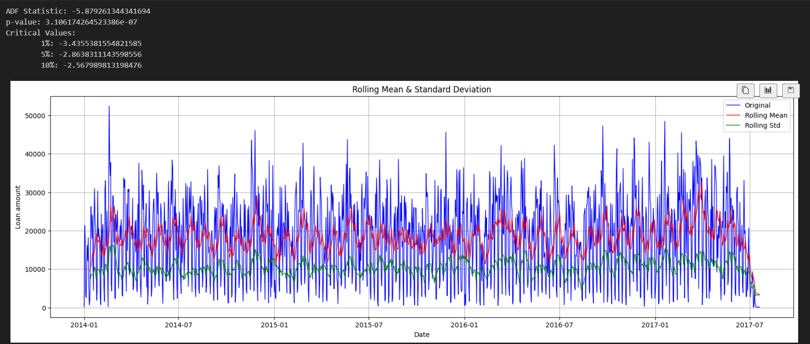
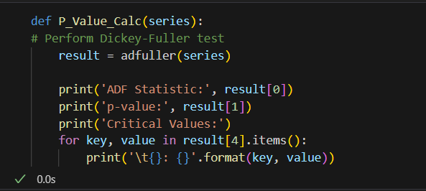
Check Standardization
We do 2 function to check Stationarity of mean,
standard division
Data already stationarity ,no need to differencing
To calculate P-value

Slide 38
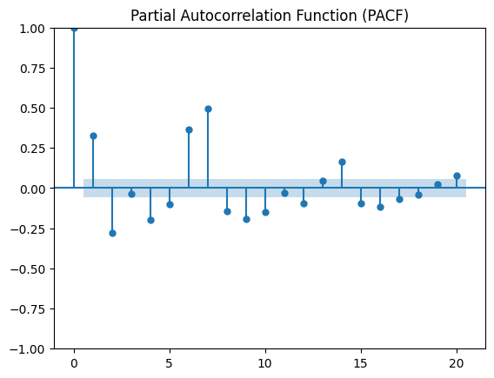
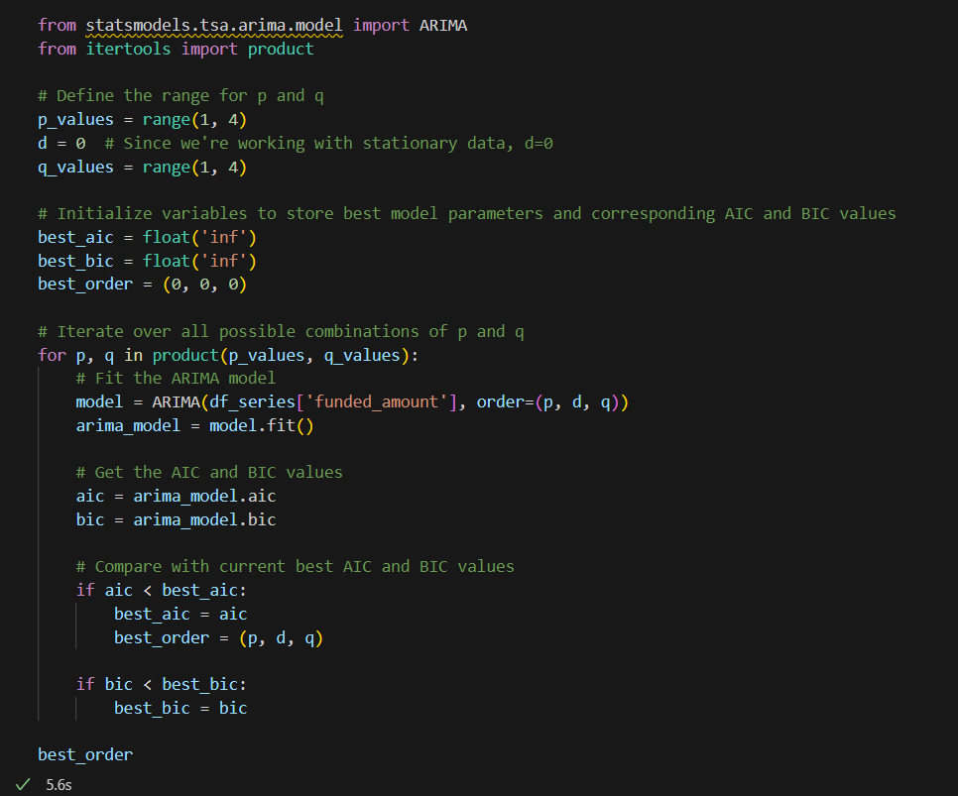
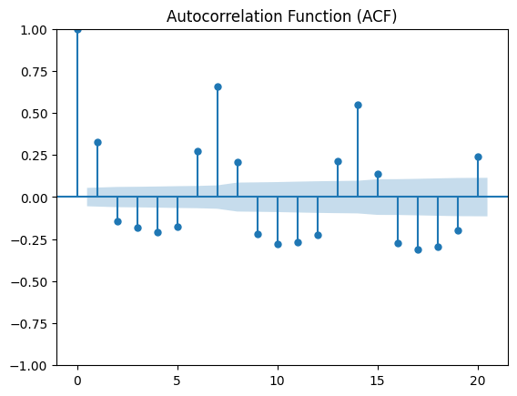
Apply Arima Model
Do 2 graph(ACF,PACF) to check q ,p parameter
Not accrued , we calculate p ,q based on BIC,
AIC to ensure Best order(3,0,3)

Slide 39
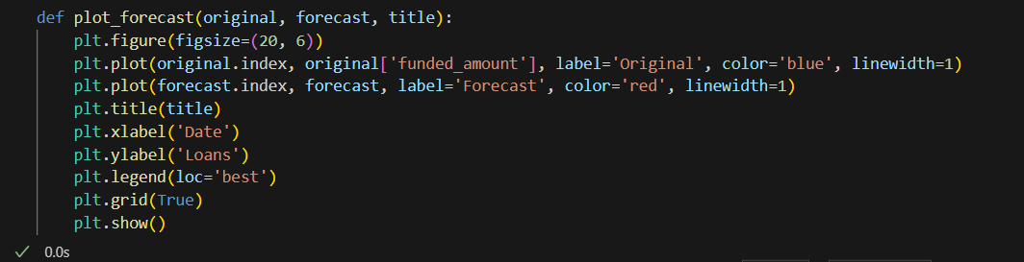
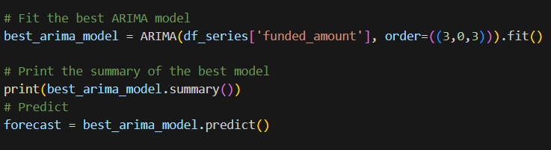
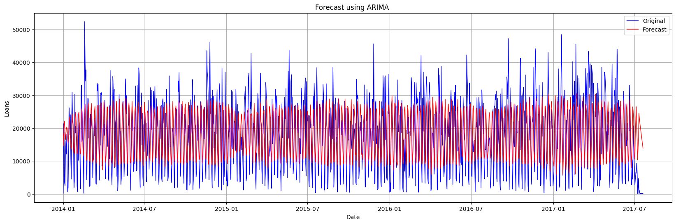
Apply Arima Model

Slide 40
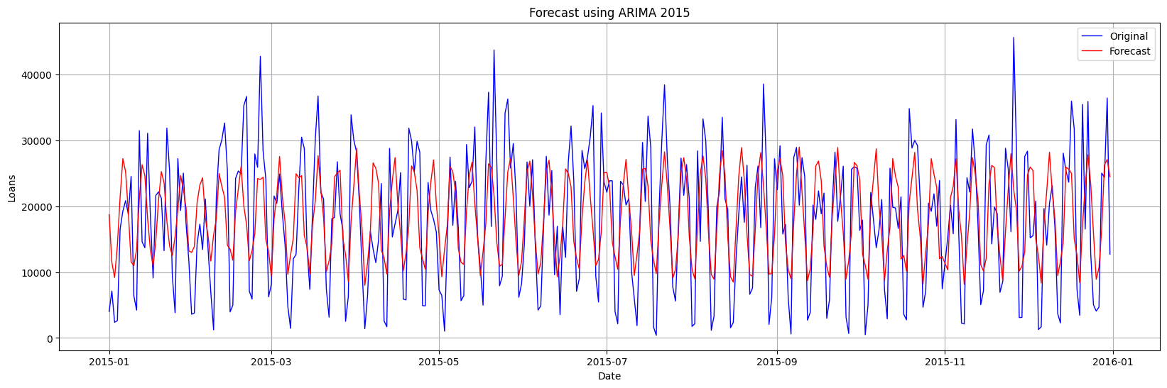
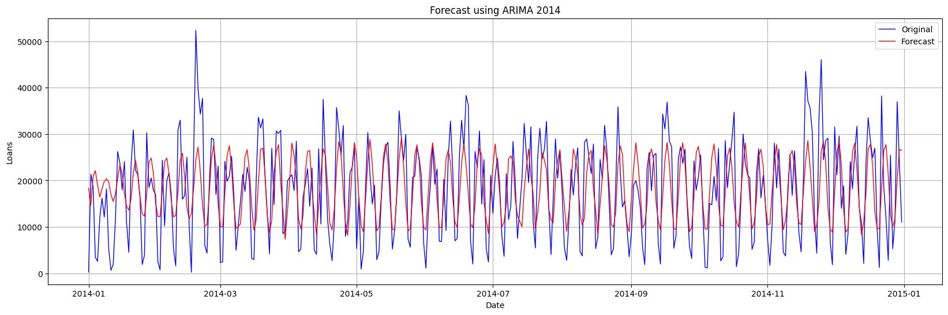
We Split data over 4 years to clear visualization

Slide 41
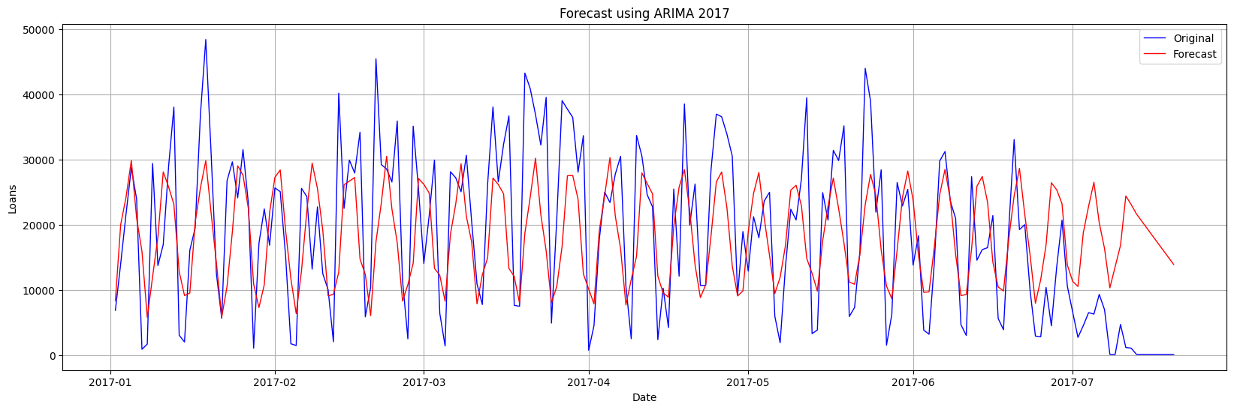
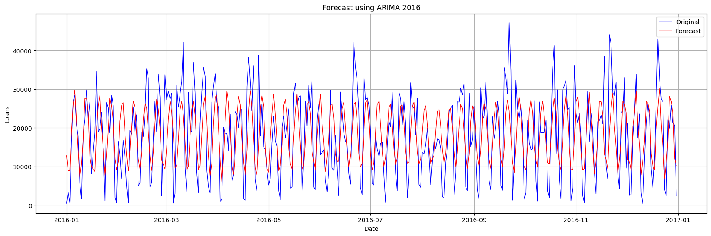
We Split data over 4 years to clear visualization

Slide 42
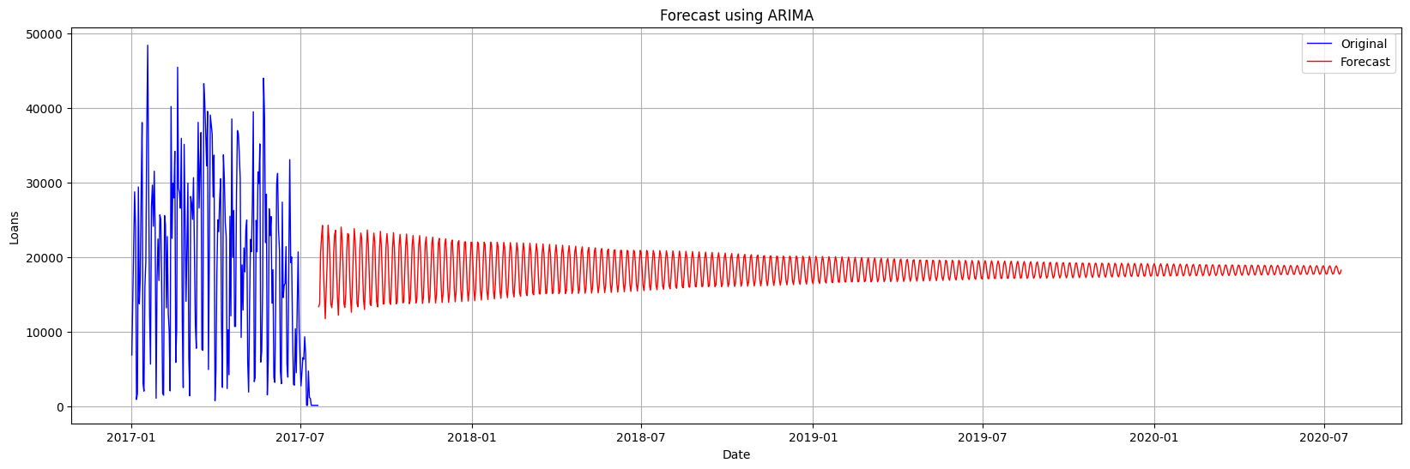
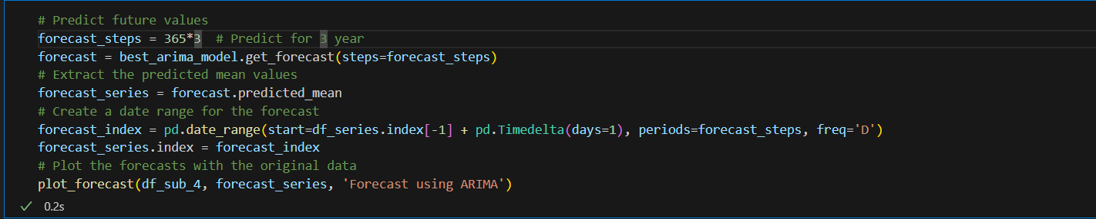
Forecasting
The model was used to forecast the next 3 years of funded amounts.
predicted_mean provides the central estimate for each future point in time. This is the core output you are interested in when making forecasts.

Slide 43
CONCLUSION

Slide 44
In conclusion, our analysis of the Kiva Loans dataset reveals crucial insights into the dynamics of microfinance. By examining attributes such as funded amounts, loan purposes, and repayment intervals, we can better understand the distribution and impact of loans across various sectors and countries. This data-driven approach highlights the significance of Kiva's efforts in providing financial support to diverse borrowers, emphasizing the role of gender, regional focus, and partner organizations. Ultimately, our findings can guide strategic decisions, ensuring more effective allocation of resources to empower underserved communities worldwide.

Slide 45
THANK YOU!

